Slide 1


Slide 2
CONTROL ENGINEERING THEROY CHAPTER 1 INTRODUCTION TO CONTROL SYSTEM
PRESENTED BY:
HUZAIFA SHAHBAZ

Slide 3
INTRODUCTION TO CONTROL SYSTEMS 1/2
Introduction
Automatic control has played vital role in the advance of engineering and science.
In addition to its extreme importance in space-vehicle systems, missile-guidance systems, robotic system and like ,automatic control has become an important and integral part of modern manufacturing and industrial processes.
For example, automatic control is essential in the numerical control of machine tools in the manufacturing industries, in the design of autopilot systems in the aerospace industries and in the design of cars and trucks in the automobile industries.

Slide 4
INTRODUCTION TO CONTROL SYSTEMS 2/2
It is also essential in such industries operations such as controlling pressure , temperature, humidity, viscosity and flow in the process industries.
Since advances in the theory and practice of automatic control provide the means for attaining optimal performance of dynamic systems, improving productivity, relieving the drudgery of many routine repetitive manual operations and more ,most engineers and scientists must now have a good understanding of this field.

Slide 5
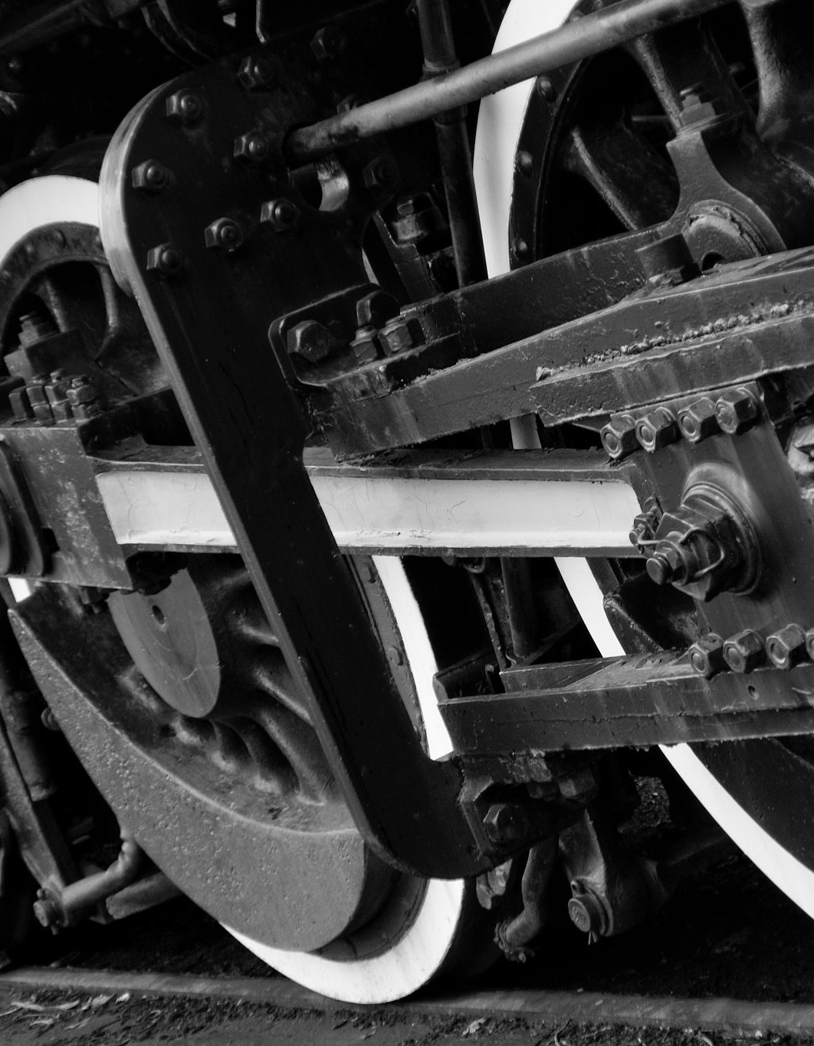
HISTORICAL REVIEW1/5
The first significant work in automatic control was James Watt’s centrifugal governor for the speed control of a steam engine in the eighteenth century.
Other significant works in the early stages of development of control theory were due to Minorsky, Hazen and Nyquist among many others.
In 1922, Minorsky worked on automatic controllers for steering ships and showed how stability could be determined from the differential equations describing the systems.
In 1932,Nyquist developed a relatively simple procedure for determining the stability of closed-loop systems on the basis of open-loop response to steady-state sinusoidal inputs.

Slide 6

HISTORICAL REVIEW 2/5
In 1934,Hazen who introduced the term servomechanisms for position control systems ,discussed the design of relay servomechanism capable of closely following a changing input.
During the decade of the 1940s, frequency-response methods made it possible for engineers to design linear closed-loop control systems that satisfied performances requirements.
From the end of the 1940s to early 1950s , the root-locus method due to Evans was fully developed.
The frequency-response and root-locus methods ,which are the core of classical control theory, lead to systems that are stable and satisfy a set of more or less arbitrary performance requirements.

Slide 7
HISTORICAL REVIEW 3/5
Such systems are ,in general acceptable but not optimal in any meaningful sense.
Since the late 1950s, the emphasis in control design problems has been shifted from the design of one many systems that work to the design of one optimal system in some meaningful sense.
As modern plants with many inputs and outputs become increasingly complex, the description of a modern control system requires a large number of equations.
Classical control theory ,which deals only with single-input-single-output systems becomes powerless for multiple-input-multiple-outputs systems.

Slide 8
HISTORICAL REVIEW 4/5
Since about 1960,because the availability of digital computers made possible time-domain analysis of complex systems, modern control theory, based on time-domain analysis and synthesis using state variables, has been developed to cope with the increased complexity of modern plants and the straight requirements on accuracy, weight and cost in military , space and industrial applications.
During the years from 1960 to 1980,optimal control of both deterministic and stochastic systems, as well as adaptive and learning control of complex systems, were fully investigated.
From 1980 to the present developments in modern control theory centered around robust control, H∞ control and associated topics.

Slide 9
HISTORICAL REVIEW 5/5
Now that digital computers have become cheaper and more compact, they are used as integral parts of control systems.
Recent applications such non-engineering systems as biological, biomedical, economic and socio-economic systems.

Slide 10
TERMINOLOGIES OF CONTROL SYSTEMS1/6
Controlled Variable and Manipulated Variable
The controlled variable is the quantity or condition that is measured and controlled.
The manipulated variable is the quantity or condition that is varied by the controller to affect the value of the controller variable.
Normally, the controlled variable is the output of the system.
Control means measuring the value of the controlled variable of the system and applying the manipulated variable to the system to correct or limit deviation of the measured value from a desired value.

Slide 11
TERMINOLOGIES OF CONTROL SYSTEMS2/6
Plants A plant may be piece of equipment, perhaps just a set of machine parts functioning together ,the purpose of which is to perform a particular operation.
Any physical object to be controlled (such as a mechanical device, a heating furnace, a chemical reactor or a spacecraft) a plant.

Slide 12
TERMINOLOGIES OF CONTROL SYSTEMS3/6
Processes The Merriam-Webster Dictionary defines a process to be a natural, progressively continuing operation or development marked by a series of gradual changes that succeed one another in a relatively fixed way and lead toward a particular result orend; or an artificial or voluntary ,progressively continuing operation that consists of a series of controlled actions or movements systematically directed toward a particular result or end.
Examples are chemical , economic and biological processes.

Slide 13
TERMINOLOGIES OF CONTROL SYSTEMS4/6
Systems A system is a combination of components that act together and perform a certain objective.
A system is not limited to physical ones.
The concept of the system can be applied to abstract, dynamic phenomena such as those encountered in economics.
The word system should, therefore, be interpreted to imply physical , biological, economics and like systems.

Slide 14
TERMINOLOGIES OF CONTROL SYSTEMS5/6
Disturbances A disturbance is a signal that tends to adversely affect the value of the output of a system.
If a disturbance is generated within the system, it is called internal, while an external disturbance is generated within the system, it is called internal, while an external disturbance is generated outside the system and is an input.

Slide 15
TERMINOLOGIES OF CONTROL SYSTEMS6/6
Feedback control Feedback control refers to an operation that in the presence of disturbances, tends to reduce the difference between the output of a system and some reference input and does so on the based of this difference.
Here only unpredictable disturbances are so specified, since predictable or known disturbances can always be compensated for within the system.

Slide 16
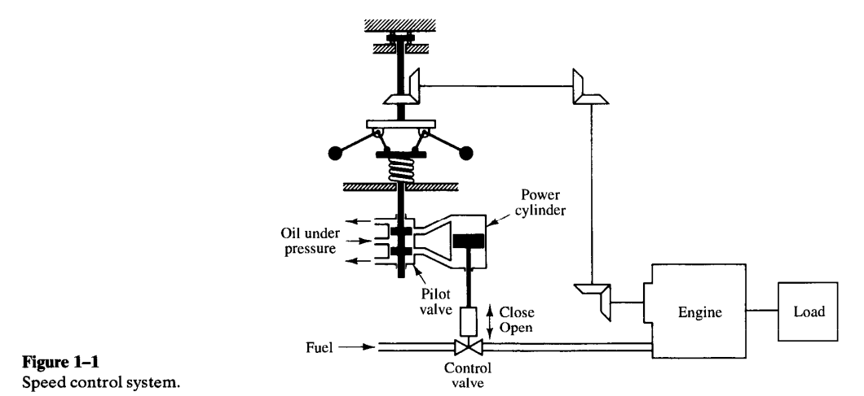
EXAMPLES OF CONTROL SYSTEMS-SPEED CONTROL SYSTEM
The basic principle of a Watt’s speed governor for an engine is illustrated in the schematic diagram of figure 1.1.

Slide 17
EXAMPLES OF CONTROL SYSTEMS-SPEED CONTROL SYSTEM
The amount of fuel admitted to the engine is adjusted according to the difference between the desired and the actual engine speeds.
The sequence of actions may be stated as follows :The speed governor is adjusted such that, at that desired speed ,no pressured oil will flow into either side of the power cylinder.
If the actual speed drops below the desired value due to disturbance, then the decreases in the centrifugal force of the speed governor causes the control value to move downward , supplying more fuel and the speed of the engine increases until the desired value is reached.
On the other hand, if the speed of the engine increases above the desired value, then the increase in the centrifugal force of the governor causes the control value to move upward.

Slide 18

EXAMPLES OF CONTROL SYSTEMS-SPEED CONTROL SYSTEM
This decreases the supply of fuel and the speed of the engine decreases until the desired value is reached.
In this speed control system, the plant (controlled system) is the engine and the controlled variable is the speed of the engine.
The difference between the desired speed and the actual speed is the error signal.
The control signal (the amount of fuel) to be applied to the plant (engine) is the actuating signal.
The external input to disturb the controlled variable is the disturbance.
An unexpected change in the load is a disturbance.

Slide 19
EXAMPLES OF CONTROL SYSTEMS-ROBOT CONTROL SYSTEM
Industrial robots are frequently used in industry to improve productivity.
The robot can handle monotonous jobs as well as complex

